Slide 1
MECH 5970/6970
Lecture 4 on Vision-based Navigation and Guidance
Sridhar Lakshmanan
Electrical & Computer Engineering
University of Michigan-Dearborn
Email: Lakshman@umich.edu

Slide 2
Fundamentals of vision-based navigation
Identify fixed points in the world over two successive image frames
Correspondence problem ← Did this in the first lecture → Quick review
Estimate the camera’s translation and rotation from these points
Inverse problem ←Algebraic tools in Lecture 2→Use it to solve the problem
New m-file with camera pose estimate overlay compared to Matlab
Assignment: Find the changing camera pose
Additional tools
Pin-hole camera perspective projection
Other interest point detectors such as FAST, BRISK, and Harris

Slide 3


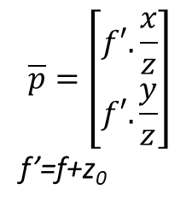

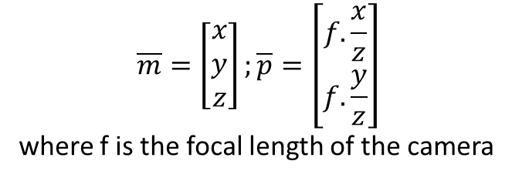
Camera model: 3D → 2D
Effect of non-pinhole aperture
Ideal pinhole
$$\overline{m}$$
$$\overline{p}=\left[\begin{matrix}f′.\frac{x}{z} \\ f′.\frac{y}{z}\end{matrix}\right]$$
f’=f+z₀
$$\overline{p}$$
$$\overline{m}$$
$$\overline{p}$$
$$\overline{m}=\left[\begin{matrix}x \\ y \\ z\end{matrix}\right];\overline{p}=\left[\begin{matrix}f.\frac{x}{z} \\ f.\frac{y}{z}\end{matrix}\right]$$
where f is the focal length of the camera
Effect of lens

Slide 4
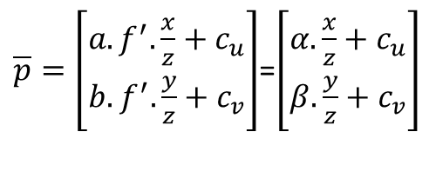
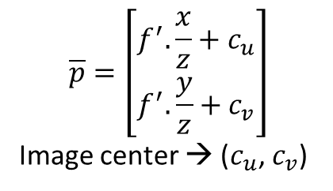
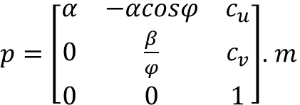

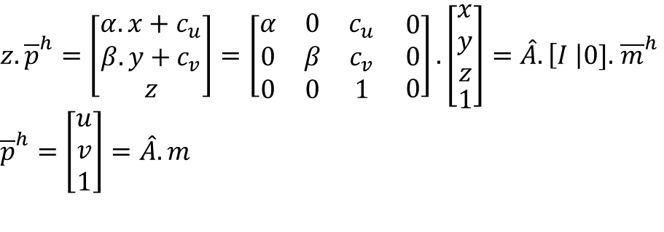
Camera model: 2D → Image
${z.\overline{p}}^{h}=\left[\begin{matrix}α.x+c_{u} \\ β.y+c_{v} \\ z\end{matrix}\right]=\left[\begin{matrix}α & 0 & c_{u} \\ 0 & β & c_{v} \\ 0 & 0 & 1\end{matrix} \begin{matrix}0 \\ 0 \\ 0\end{matrix}\right].\left[\begin{aligned}\begin{matrix}x \\ y \\ z\end{matrix} \\ 1\end{aligned}\right]=\hat{A}. \left[I \right|0].$ ${\overline{m}}^{h}$
$${\overline{p}}^{h}=\left[\begin{matrix}u \\ v \\ 1\end{matrix}\right]=\hat{A}.m$$
$$\overline{p}=\left[\begin{matrix}f^{′}.\frac{x}{z}+c_{u} \\ f^{′}.\frac{y}{z}+c_{v}\end{matrix}\right]$$
Image center → ($c_{u}$, $c_{v}$)
$${\overline{m}}^{h}$$
What is Skewness? Image is skewed when the camera coordinate system is skewed – i.e., the angle between the two axes is not exactly 90º. Cameras could have skewness due to sensor manufacturing errors/tolerances.
On the image, points are in units of pixels and not in units of length (m or cm)
$p=\left[\begin{matrix}α & −αcosφ & c_{u} \\ 0 & \frac{β}{φ} & c_{v} \\ 0 & 0 & 1\end{matrix}\right]$. $m$
$\overline{p}=\left[\begin{matrix}{a.f}^{′}.\frac{x}{z}+c_{u} \\ b.f^{′}.\frac{y}{z}+c_{v}\end{matrix}\right]$=$\left[\begin{matrix}α.\frac{x}{z}+c_{u} \\ β.\frac{y}{z}+c_{v}\end{matrix}\right]$
A (see A matrix definition in Lectures 1/2/3)

Slide 5
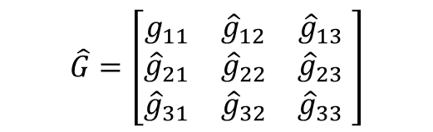

Inverse problem in 2D
${\{p_{i}εR^{3}: p}_{i}(t$) = [$u_{i}(t$), $v_{i}(t$), 1] = A . m_{i}(t), i=1,2,…I}
are the pixel coordinates of I the visible points on π
Projection
Matrix
Known
Unknown
$$\hat{G}=\left[\begin{matrix}g_{11} & {\hat{g}}_{12} & {\hat{g}}_{13} \\ {\hat{g}}_{21} & {\hat{g}}_{22} & {\hat{g}}_{23} \\ {\hat{g}}_{31} & {\hat{g}}_{32} & {\hat{g}}_{33}\end{matrix} \right]$$
Known
Is the projection of ${\overline{m}}_{i}\left(t\right)$ onto the image-pixel coordinate axis
1

Slide 6
Homework (Due 10/21/2019)
Problem 1
Consider the CameraPoseEstimate.m file:
Calculate the error between “true” (Matlab toolbox output) and “estimate” (Class calculation output) for the camera translation and rotation between the camera pose for ‘Google-maps-ref.jpg’ and the camera pose for the cropped image of the same.
Plot a graph of these two errors as a function of number of features matched between the two images
Problem 2
Consider the images ‘Shelby-left.jpg’ ‘ ‘Shelby-right.jpg’. By estimating the camera rotation matrix for these two images against ‘Shelby-ref.jpg’ can you describe what happened to the camera in each case? (Please use ‘Matrix Rotations and Transformations’ help file within Matlab)
Problem 3
In this problem we want to compare the efficacy of the various interest point detectors. Repeat Problem 2, but this time with BRISK, Harris and FAST interest point detectors instead of SURF.

